Slide 1
ECOMMERCE WEBSITE
Celestial Cart

Slide 2
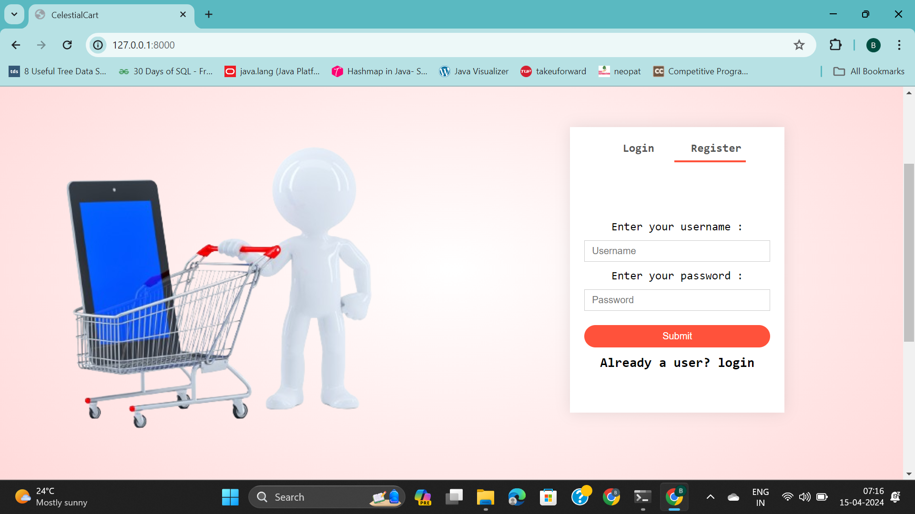
LOGIN PAGE

Slide 3
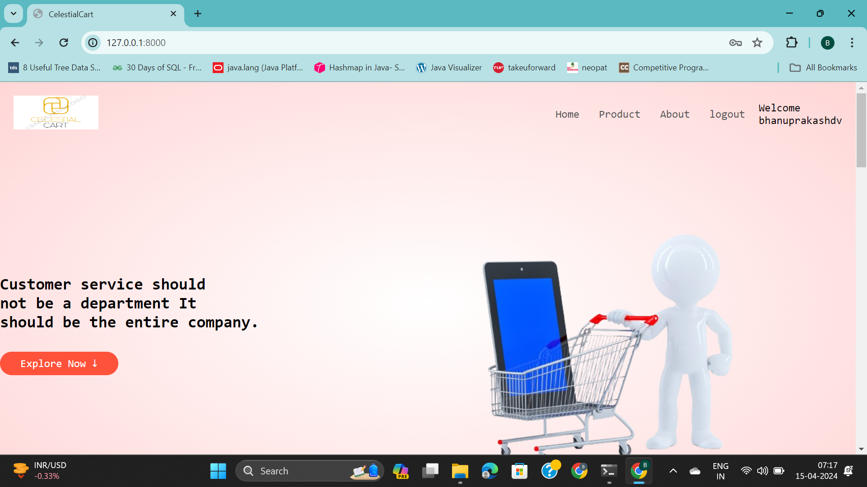
HOME PAGE

Slide 4
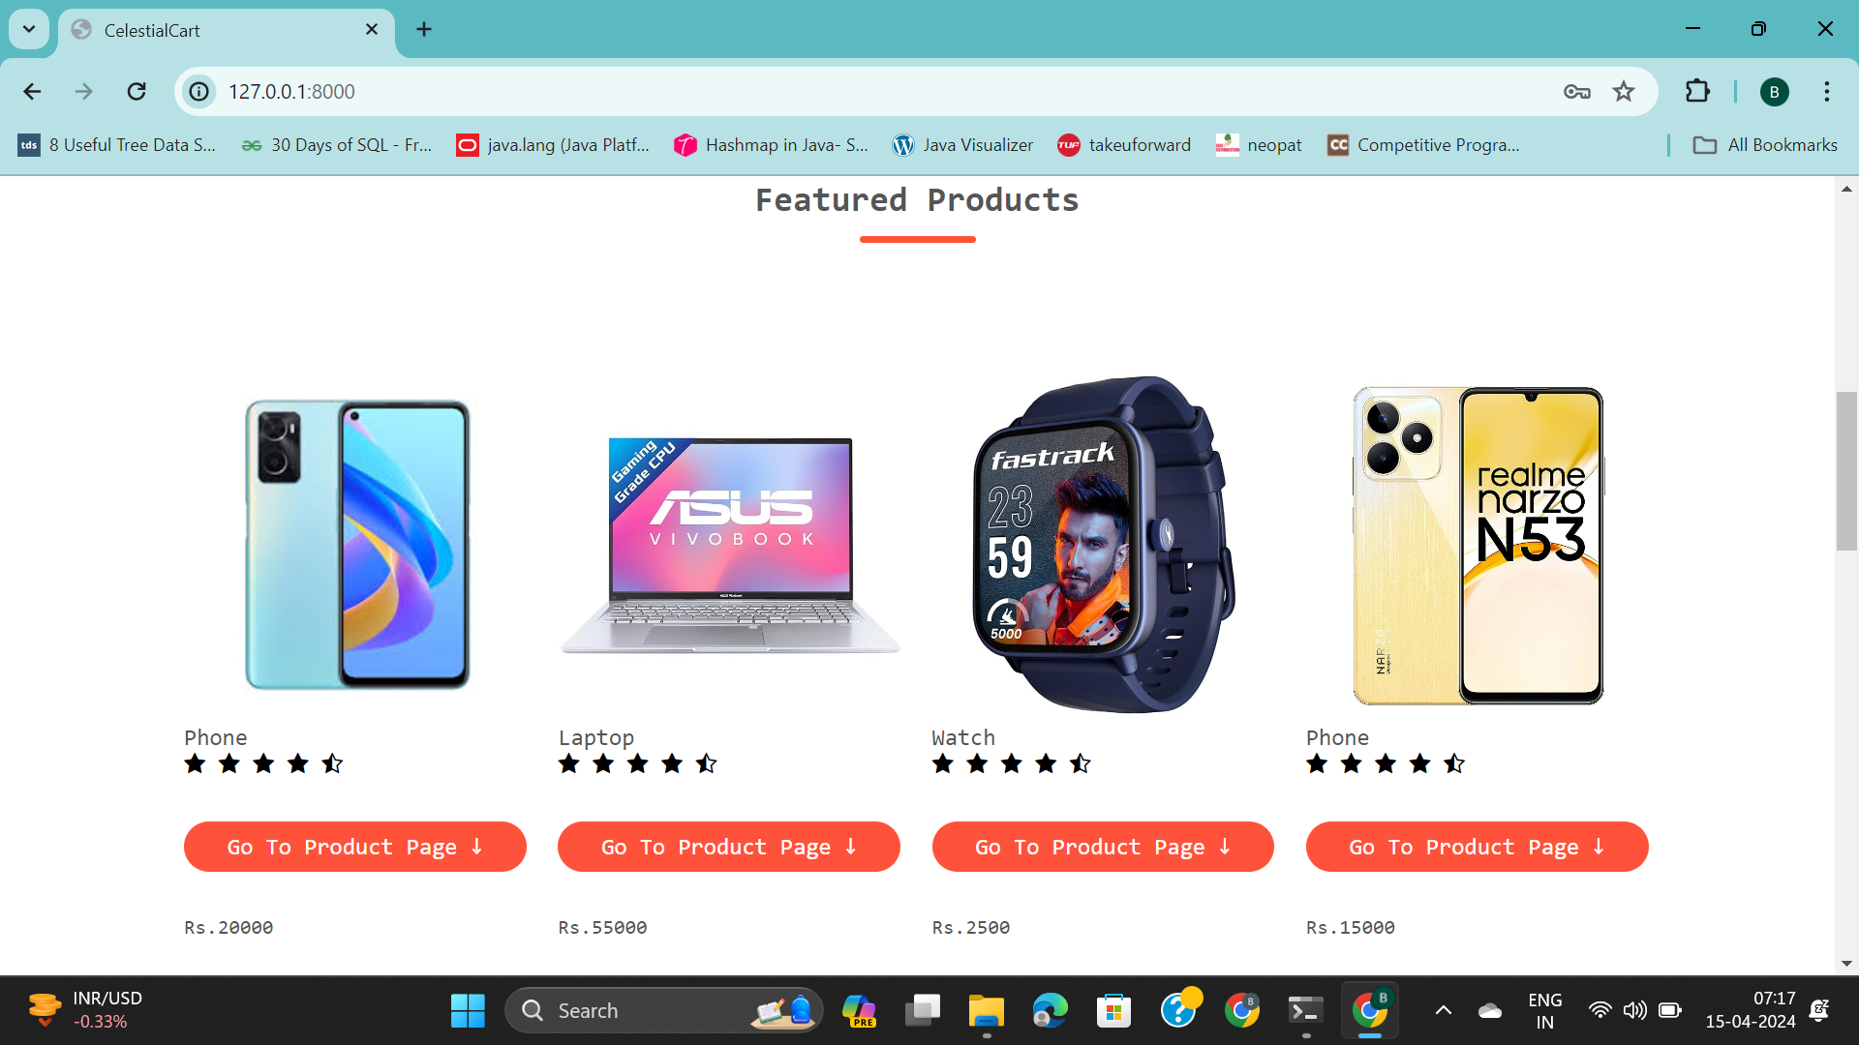
FEATURED PROJECTS

Slide 5
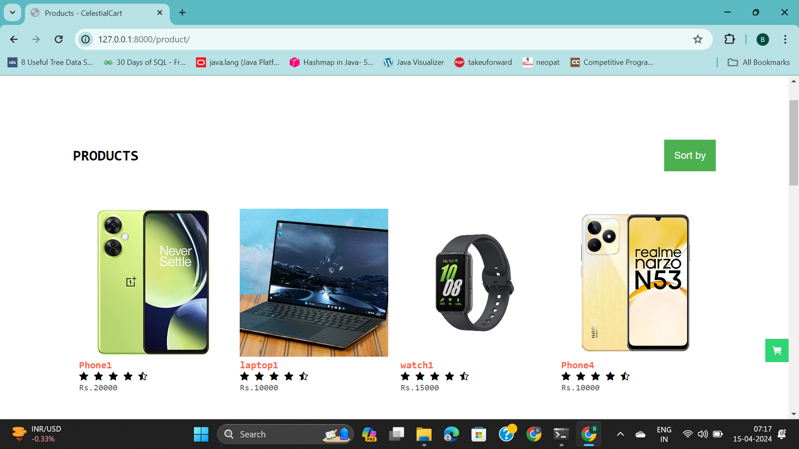
PRODUCT PAGE

Slide 6
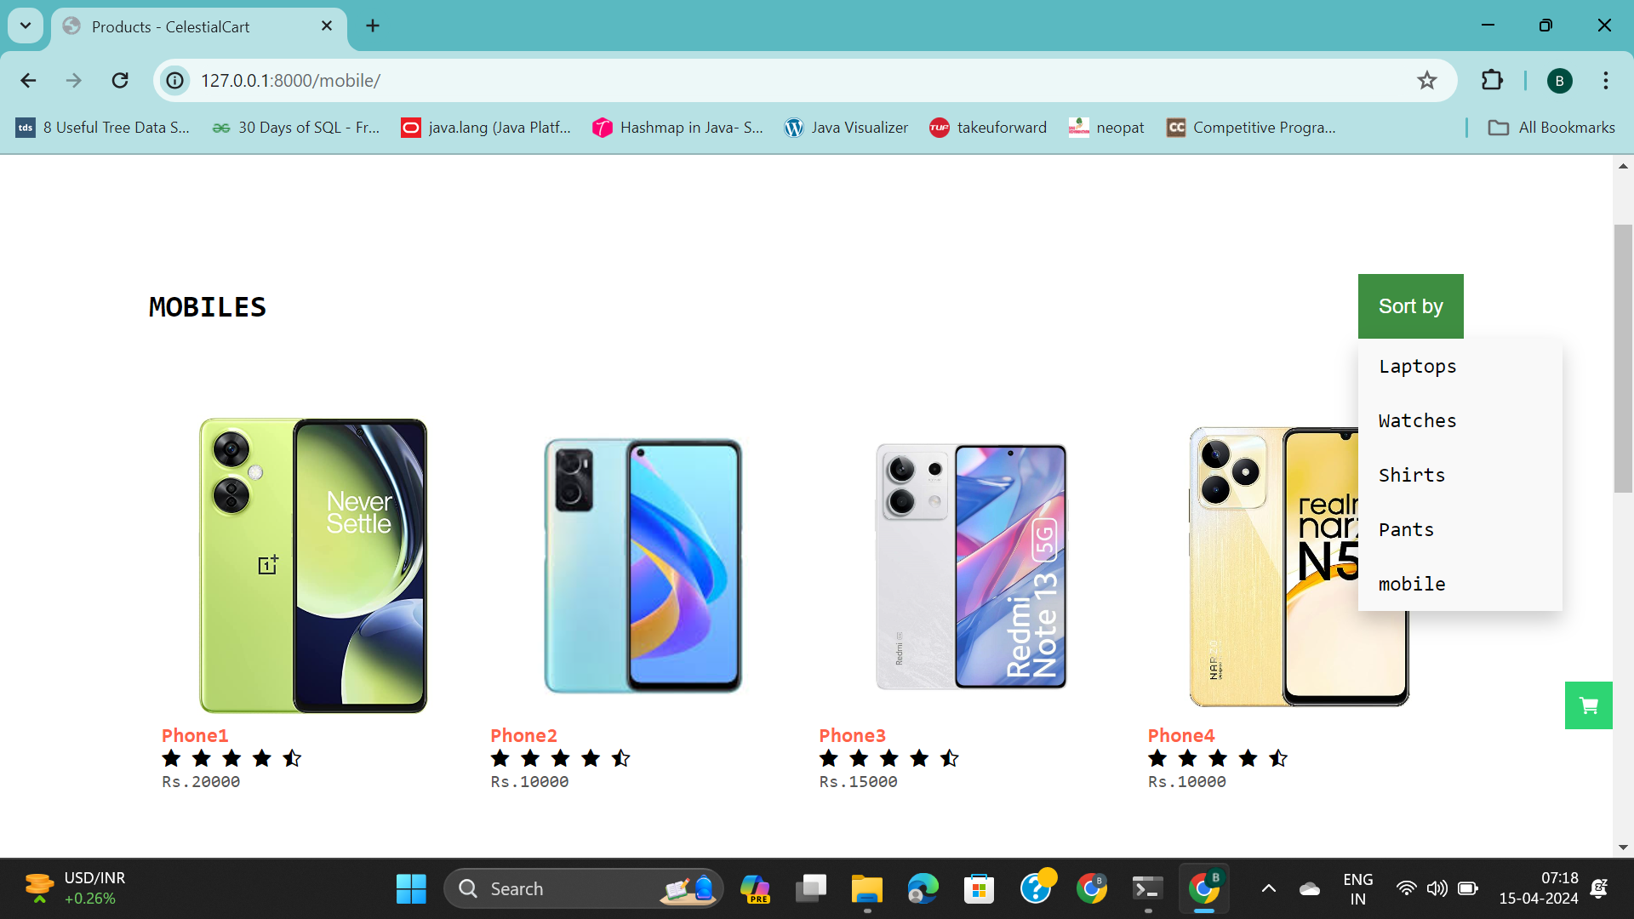
MOBILES

Slide 7
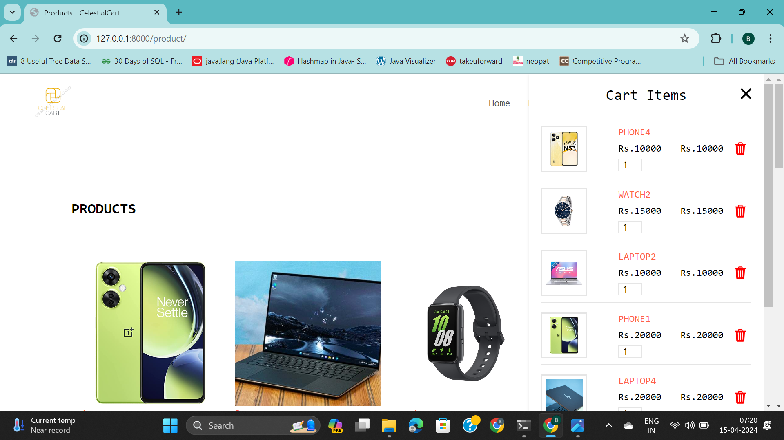
CART

Slide 8
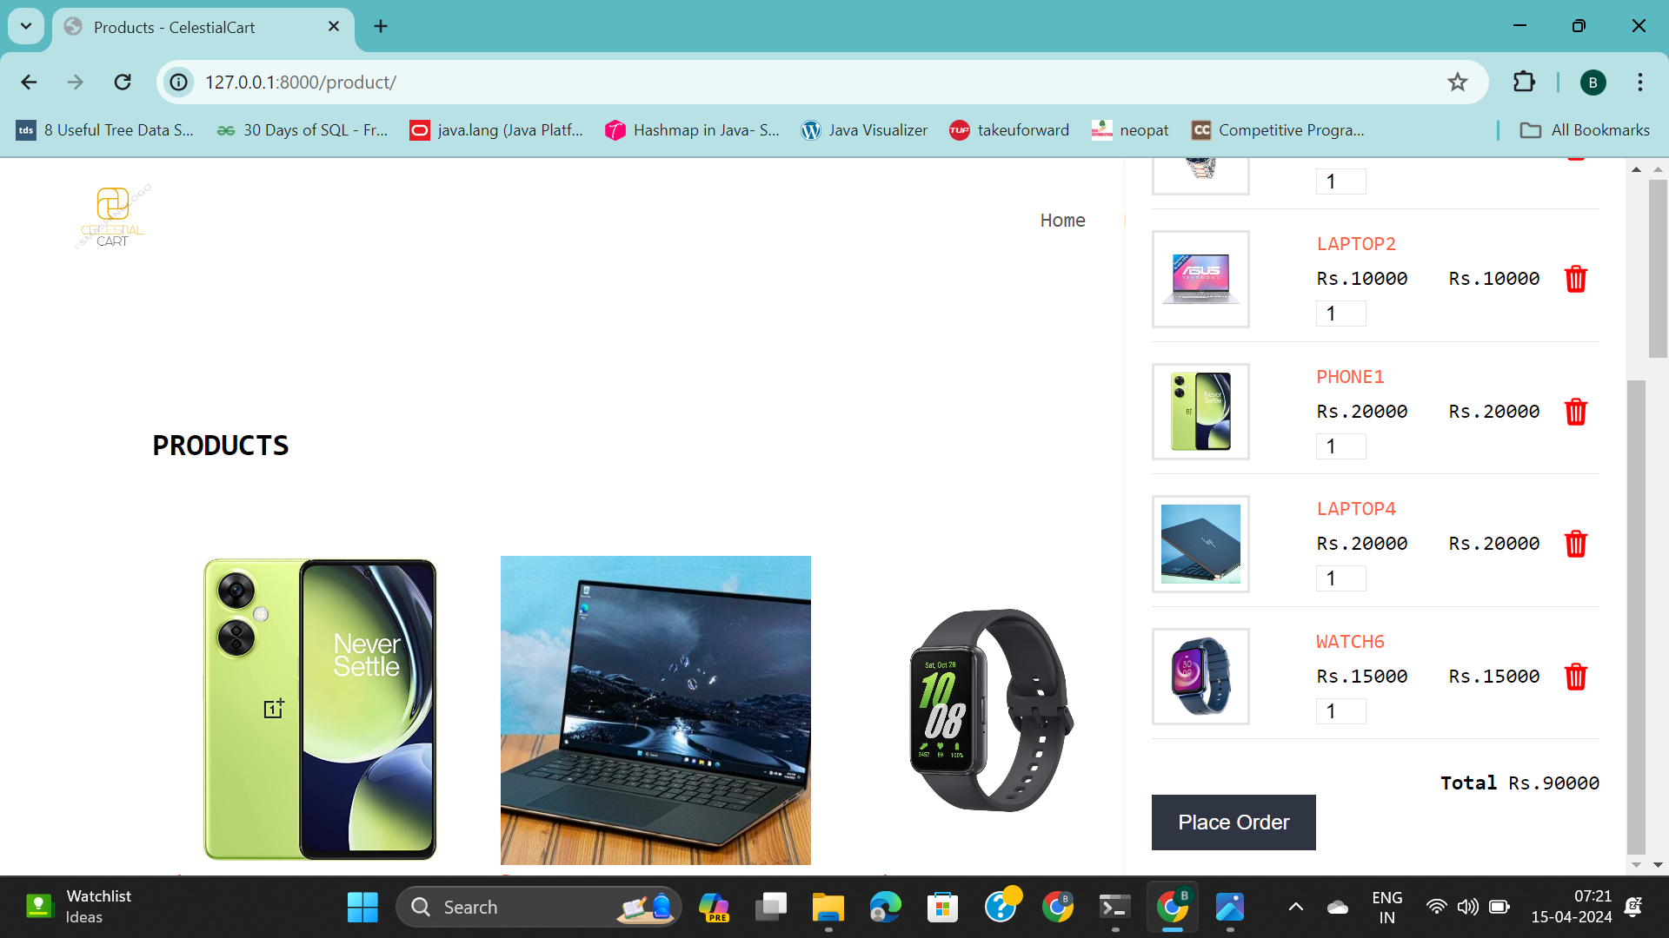
CART

Slide 9
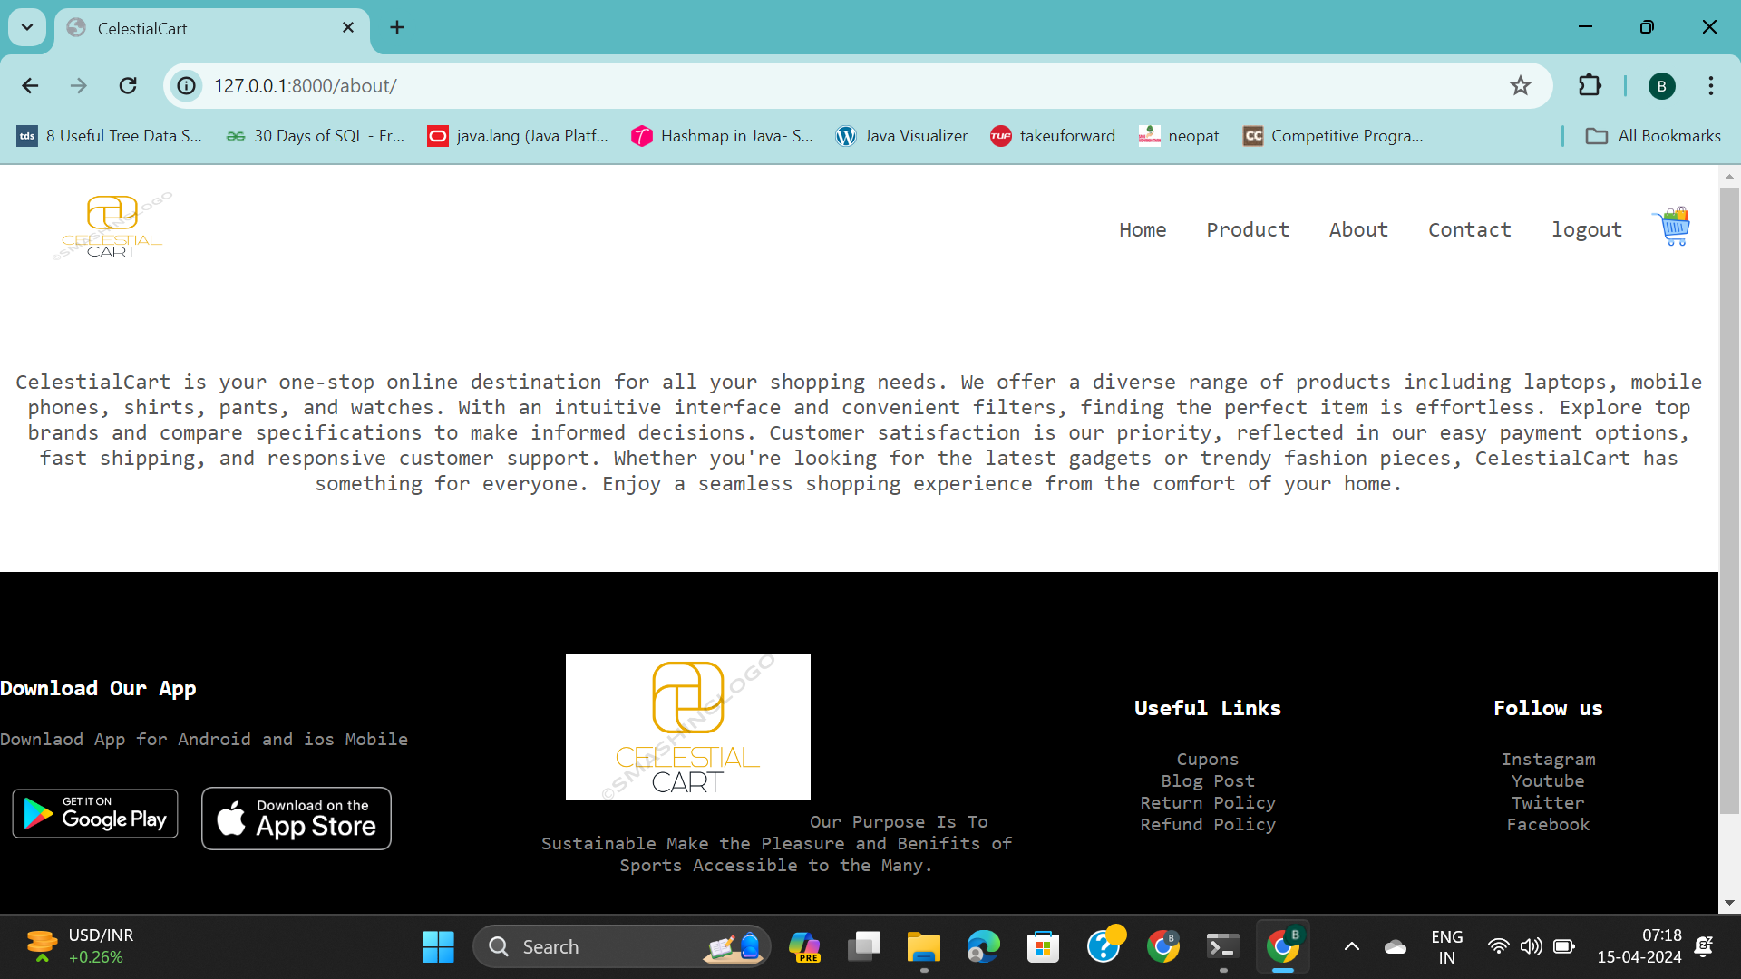
ABOUT PAGE

Slide 10


